Slide 1
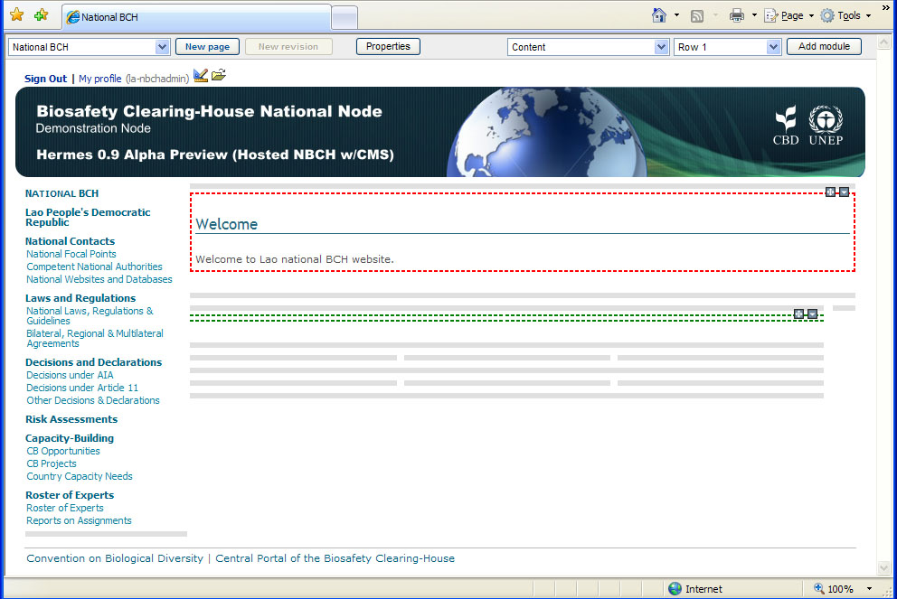
More Examples on Adding Modules
Then, a new module will be added to this page as shown.
NEW MODULE

Slide 2
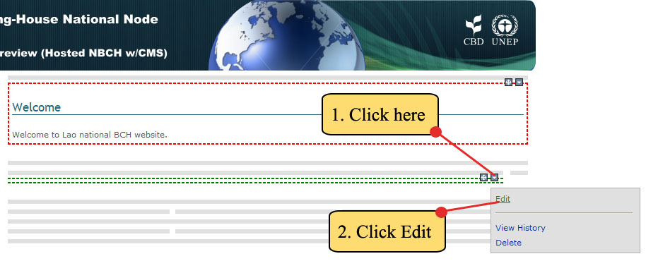
More Examples on Adding Modules
Step 2. Click on the icon. The content module menu will appear, then click EDIT.

Slide 3
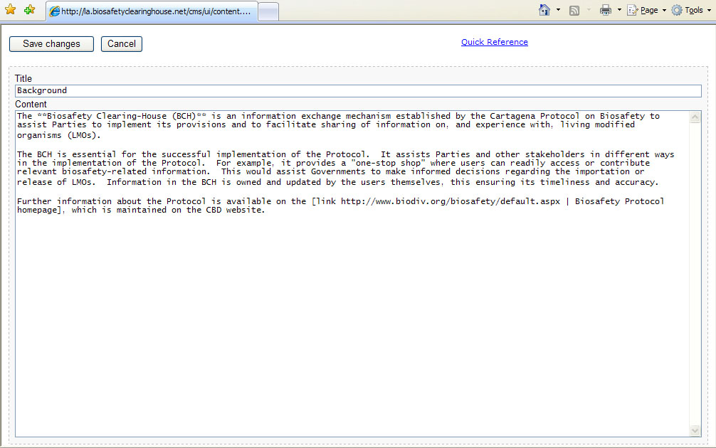

More Examples on Adding Modules
The content editor page will then appear on screen.
Step 3. Using the content editor web page, type the following data:
Using the content syntax:
For the first sentence of the first paragraph, **Biosafety Clearing-House (BCH)** when implemented will make the phrase “Biosafety Clearing-House (BCH)” to appear bold.

